Slide 1
CSE 208 Project Presentation
Ethan Belculfine
Adeeb Alqahtani
Abdulrahman Aljurbua
Fall 2016
Notes:
Ethan Belculfine - 004942414

Slide 2
Ideas
Preferably something that uses visual sensors, motion sensors (Dr. Sun said he would provide us with these types of sensors)
I’m thinking of a project that
1-protects kids in school, like classroom security system.
Or 2- something that ensure kids safety on their way home.

Slide 3
Motion/Visible Light Activated Street Lamps
(Based on idea for ensuring kids safety on way home - subset of broader public safety field)
Street lamps activated/controlled by lack of light and presence of person or living thing nearby.
Saves energy; allows easier detection of living things nearby, and therefore more public safety
Uses light sensor to detect presence of light in atmosphere and motion sensor to detect presence of living things nearby.
Can make use of visible light sensor to detect things like cars
Lamp powered at low level when it is dark outside (light sensor is below threshold), outputs more power when person/living thing is near lamp (motion sensor detects something) and possibly when car or moving object goes by (visible light sensor detects something). Lamp is off in all other conditions
Something similar to this: https://www.youtube.com/watch?v=X9y2k5CjsA8
Can be expanded to other existing public commodities, or to things like air conditioning
information like human and vehicle traffic are gathered and weekly report it to the city so decisions on improving streets safety and public facilities according to the data gathered can be made.
Examples for public facilities could be like, street rest bench. Improving safety like 1-making specific sides for bicycles when high bicycles activity is detected in some areas. 2-monitoring human activity at night in some areas for safety purposes..
Reporting the police when heavy traffic is an issue.
Wild Animal activity can be send to wild animal control to ensure the safety of nearby houses.

Slide 4
Street Lamp idea cont.
System is helpful for high-velocity object sensing (cars, trains, etc.) - sensors can anticipate where something will travel and light lamps in advance
System can use solar power and/or electric grid to power wireless sensors and energy efficient lights.
Useful for places like universities or parks where security is an issue
System useful in that it saves power and provides effective way to detect people/animals that are close by
Can keep track of energy consumption data..
Can be part of wireless sensor networks to provide light for high-velocity targets, such as cars or people on bicycles
Network can obtain information about human traffic in areas - can be used to determine usefulness of lights in certain areas (which can be used to determine more effective source of power, i.e. solar energy or grid power), can be used for security of certain areas (maintaining curfew, detecting wild animals, …)

Slide 5
Street Lamp idea cont.
Motion sensor ideal for this system - motion sensors can only detect presence of humans or animals. Visible light sensors would detect all types of movement, including wind movement, which would make them inefficient. Same can be said about other types of sensors - detects too much
System ideal for walkways, where humans can be easily detected by motion sensor
TinyOS should be sufficient for basic functionality, other operating system might be necessary for more complex functionality
Information obtained by system could be used for other existing public commodities, or for potential new technology
Necessary amount of sensors is based on usage - if looking for movement in all directions, many sensors might be necessary for each light. Not all lights likely to have full radial coverage, but those who require it likely only need a maximum of three sensors. (All uses likely require < 3)

Slide 6
Street Lamp idea cont.
Overview:
Provide lighting to those in need, while remaining energy efficient
Includes street lamps in large open areas such as on sidewalks, or lamps on bridges or tunnels, or other somewhat confined spaces
Lamps provide low amount of energy when no presence, increase light when people or other living things come near
Network communication to provide light for moving targets - be able to provide light on target’s path
Network should send information about presence to those in need, such as authorities trying to maintain a curfew

Slide 7
Street Lamp idea cont.
Goals:
Range should be far enough to effectively detect people in need of light, not just those directly next to sensor
System should accommodate high-velocity targets such as bicycles to ensure sufficient lighting
Possibly be able to gain information about things being detected (size, amounts, physical features, etc.)
Possibly be used in conjunction with other sensors or technologies, such as cameras (could provide similar uses to wildlife monitoring, only for living things near the lamp)

Slide 8
Street Lamp idea cont.
Timeline:
Be able to detect simple presence and power lights using this information
Be able to utilize system that can detect fast-moving objects and more effectively provide light
Be able to obtain more specific information about targets - size, amount of people/objects, other physical features
Be able to send information about targets to those who need/desire information

Slide 9
Motion-Activated Street Lamps
And Walkway Illumination

Slide 10
Purpose of Proposed System:
The intended function of the proposed system is light control
Its primary purpose is improved public safety, energy efficiency and public services

Slide 11
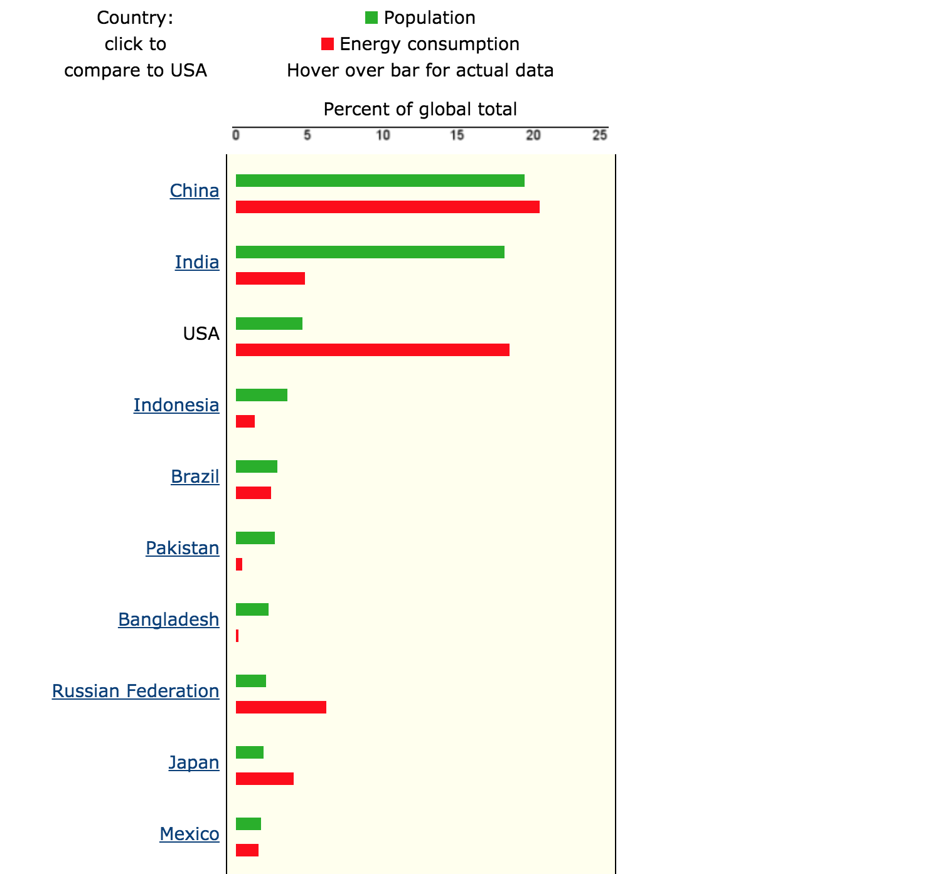
Energy Consumption Data

Slide 12
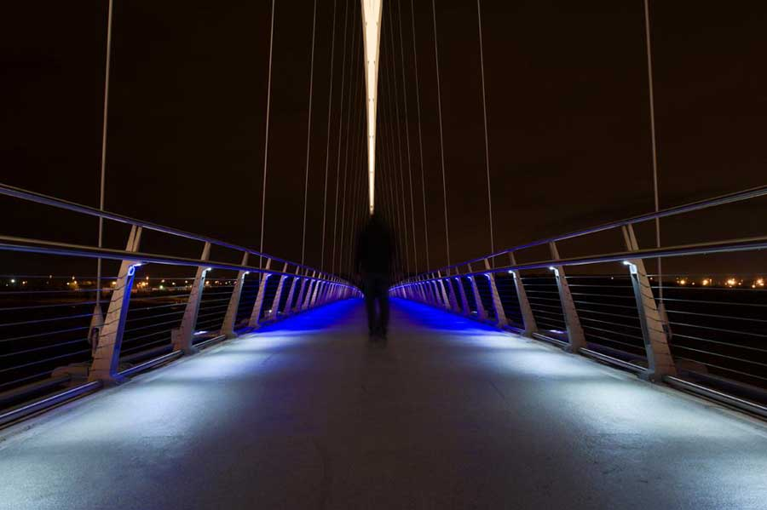
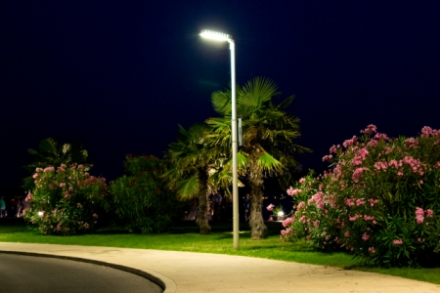
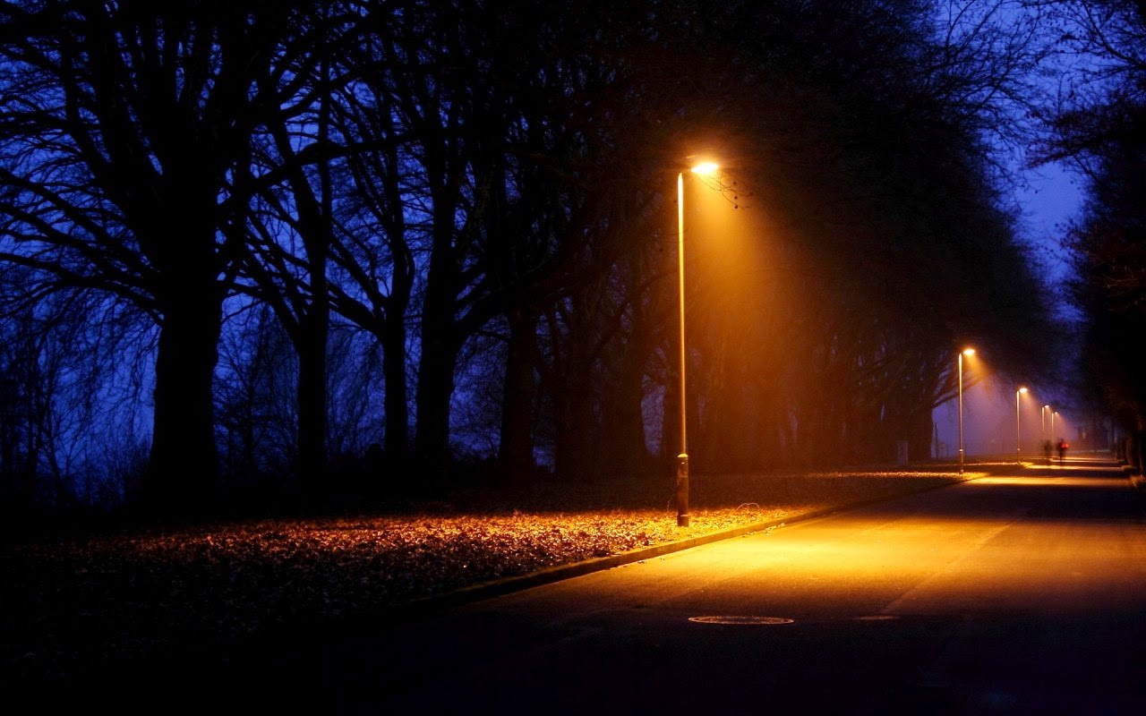
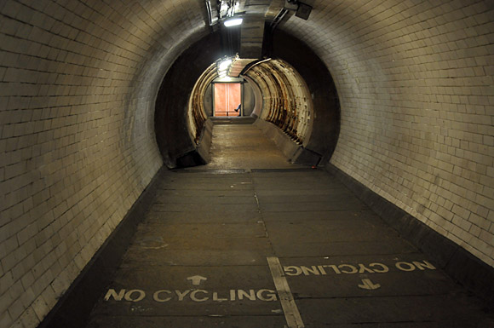
Includes:
Basic street lamps that run along roadways and sidewalks
Lights that run along walkways
Lights that illuminate bridges
Lights that illuminate tunnels

Slide 13
Other Uses
The intended use of the proposed system is light level control for street lamps and other related lights.
The information supplied by this system could also be used for:
Surveillance
Apart from human detection, this system would be useful in the detection of high-velocity objects. This includes:
Cars
Trains
Motorcycles
Carts
ATV’s
Boats

Slide 14
The Initial Model:
Single Lamp Setup

Slide 15
Functional Description - Initial Model
Our initial goal is to create a system that involves a single lamp.
This lamp has three light level settings: Off, Low, and High. The lamp will provide light based on two parameters: Presence of atmospheric light and human presence.
Lamp is set to Off when: Atmospheric light is above the set threshold.
Lamp is set to Low when: Atmospheric light is below the set threshold, and human presence is not detected.
Lamp is set to High when: Atmospheric light is below the set threshold, and human presence is detected.

Slide 16
Functional Description - Initial Model
The system will need a visible light sensor to detect visible light in the atmosphere. A lower threshold will have to be defined and compared to the output of the sensor to determine if the lamp needs to produce light.
Once atmospheric light is below this threshold, the rest of the system powers on.
Lamps are initially set to a low level and will put out a constant amount of light, regardless of human presence. Light levels are increased when human presence is detected.

Slide 17
Functional Description - Initial Model
Human presence is detected with the use of motion sensors. As humans walk near the lamp, these sensors output a 1-bit signal to a light level controller.
When the controller receives this signal, the accompanying lamp is set to its higher level of brightness.
This simple model will allow us to test the capabilities of our sensors and create an effective method of human detection. Once this basic model works sufficiently well, we will be able to add functionality and increase the scope of what the system can do.

Slide 18
Functional Description - Initial Model
Many motion sensors have a 90 degree field of view. Assuming the sensors being used have this field of view, as many as four will need to be used for any application. As little as three can be used if the light is at the edge of an open corner, as little as two can be used if the light is against a flat wall, and only one is necessary if the light is at the edge of a closed corner.

Slide 19
Technology Used - Initial Model
Motion Sensors - passive infrared sensors; enough to create an effective detection field
LED Lights - for energy efficiency
Light Level Controller - likely a simple digital pulse width modulator (PWM)
Power Source - either a solar panel and battery, connection to power grid, or simple replaceable battery
Atmospheric Visible Light Sensor - used to determine when lights are necessary

Slide 20
Additional Functionality
Multi-Lamp System

Slide 21
Functional Description - Second Model
This second model provides all the functionality of the first. Additionally, this model will be able to predict where targets are going, and provide light on the path ahead of the target.
This functionality will be especially useful for higher-velocity targets such as runners or bicyclists, or for anyone walking along a set path, such as through a tunnel or over a bridge.
In this model, a group of individual lamps will have to communicate with one another to accurately predict where targets are moving.

Slide 22
Functional Description - Second Model
A wireless sensor network will need to be implemented to provide effective communication among a network of lamps.
Lights in a network will need to light a path at roughly the same speed its target is moving.
Lights among the network will also need to ensure that each section of the path is illuminated before the target gets to it, and not after the target has already arrived.

Slide 23
Functional Description - Second Model
Path prediction algorithms will be easy to develop for closed paths, where targets can only go in one of two directions, such as tunnels or walkways with guardrails.
For these types of paths, only speed and direction on a one-dimensional path will be needed to be taken into consideration. Since the path is one dimensional, lamps will only need to run along a straightaway, which means that lamps along the path will only need two sensors each.

Slide 24
Functional Description - Second Model
The order in which the two sensors are triggered as the target moves along the path will be able to determine the direction in which the target is going. The rate at which the target enters and exits the field of view of the sensor would provide a sufficient measurement of speed. To calculate this value, an additional timer will need to be used.
Lamps at corners along closed paths, where only one motion sensor is necessary, will be able to calculate speed using the same method described above. Since the lamp is at a closed corner, any immediately adjacent lamps will likely need to be lit, so direction does not need to be calculated.

Slide 25
Functional Description - Second Model
For lamps that are not on closed paths, direction will not be one-dimensional, so speed and direction will not be calculated using the same method.
Methods for measuring velocity using motion sensors exist today, and many of these methods provide accurate results. Further research will be needed to adapt current methods of velocity measurement or develop new ones to fit with this application.

Slide 26
Technology Used - Second Model
Additional Tech - Second Model:
Additional Timer - for calculations of velocity
Technology to enable communication among different lamps - should include way to send and receive data to other lamps

Slide 27
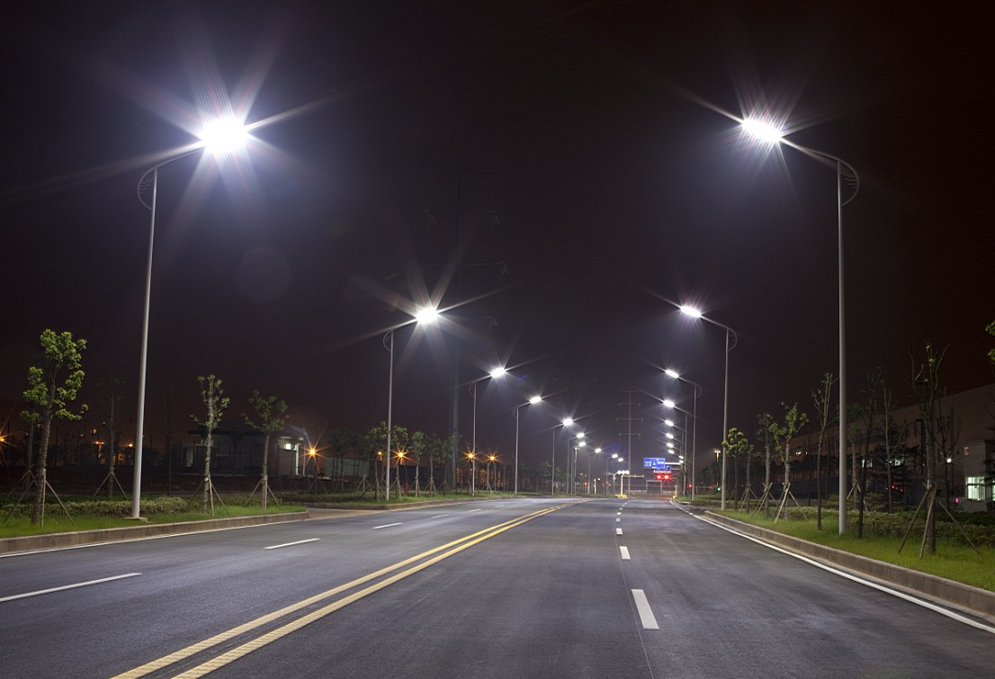
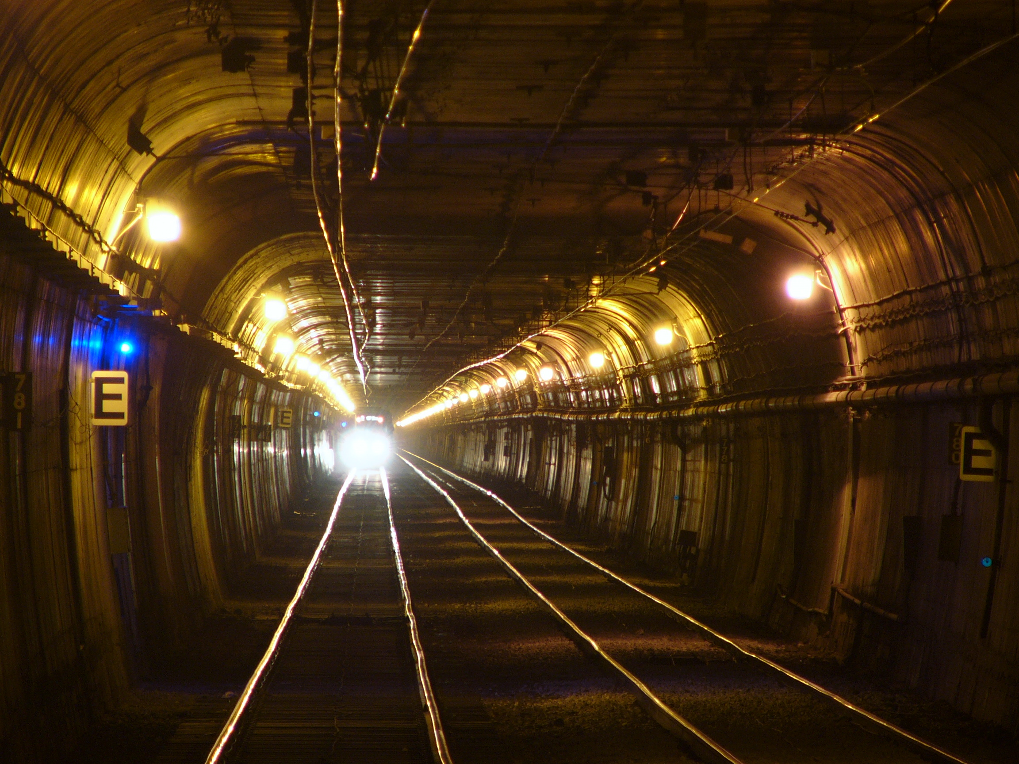
Additional Functionality
Ability to sense cars and other transportation vehicles

Slide 28
Functional Description - Third Model
The third model includes all of the functionality of the previous two models, as well as the ability to detect transportation vehicles, such as cars, trains, motorcycles, and ATV’s.
The first two models use passive infrared sensors to detect humans and other living things as they come near our lamps. If all transportation vehicles involved give off ample amounts of infrared light, then the previous model will be sufficient. If not, then visible light sensors will need to be used.

Slide 29
Functional Description - Third Model
Visible light sensors are able to detect objects that do not radiate infrared light. These sensors are more costly, and require more resources than motion sensors to operate.
Visible light sensors will be used to give similar results as motion sensors, which is the simple presence of something. This means these sensors can be implemented the same way as our motion sensors.

Slide 30
Technology Used - Third Model
Additional Tech - Third Model
Visible Light Sensors - for the detection of non-living things

Slide 31
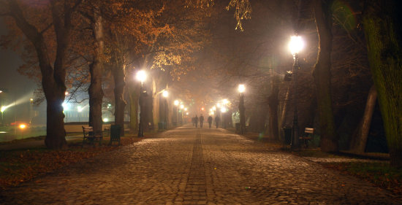
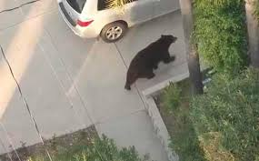
Additional Functionality
Ability to obtain information about targets

Slide 32
Functional Description - Fourth Model
This model contains all of the functionality of the first two models, but not necessarily the third. It also includes the capability of sensors to detect and record the attributes of targets.

Slide 33
Technology Used - Summary
Necessary tech - Initial Model
Motion Sensors - passive infrared sensors; enough to create effective detection field
LED Lights - for energy efficiency
Light Level Controller - likely a simple digital pulse width modulator (PWM)
Power Source - either a solar panel and battery, connection to power grid, or simple replaceable battery
Atmospheric Visible Light Sensor - used to determine when lights are necessary

Slide 34
Technology Used
Additional tech
Supplementary tech
Visible Light Sensor - for detection of non-living entities, useful for detection of cars and other high-velocity objects
Memory Storage Device - for long-term storage of information

Slide 35
Possible Future Improvements
Data gathered by the system could be a great reference to enhance public services and safety.
Could be a data base for wildlife activity in residential areas in order to improve safety.
The system could be a part of a bigger network like smart city system.

Slide 36
Energy Efficiency Implications
Environmental
Most of the power comes from nonrenewable sources. According to EIA, commercial and institutional buildings and public street and highway lighting consumed about 258 billion kWh for lighting in 2015. So, the system will help reduce energy consumption and also use clean energy to save the environment..
Economic
Spending less on energy led to more investments on other sectors creating more jobs.

Slide 37
Public Safety Implications
Current methods of energy usage reduction involve shutting off public lights for extended periods of time. This creates a public safety hazard.
The proposed system is meant to provide proper illumination of various types of walkways and other thoroughfares.
The system would also serve as a way of signaling human or wildlife activity to anyone using said roadways or thoroughfares.

Slide 38
Topics Involved
This project is useful for a number of purposes, such as:
Human detection
Human tracking
Human localization

Slide 39
Human Detection
Human detection is the primary function of this system.
Motion sensors detect the presence of humans or other living things and adjust light levels accordingly

